Slide 1
Introduction
SATELLITE COMMUNICATION
ETT 06104

Slide 2
Introduction
A satellite is simply any body that moves around another (usually much larger) one in a mathematically predictable path called an orbit
A communications satellite (Comsat) is an artificial satellite stationed in space for the purposes of telecommunications.
A communication satellite is a microwave repeater station in space that is used for telecommunication

Slide 3
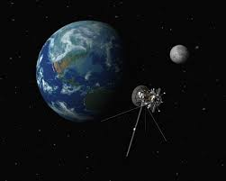
Natural satellite Vs Artificial satellite

Slide 4
A natural satellite is any celestial body in space that orbits around a larger body
Moons are called natural satellites because they orbit planets.
Satellites that are made by people and launched into orbit using rockets are called artificial satellites. There are thousands of artificial satellites orbiting the Earth.

Slide 5
Planets, asteroids and comets orbit around stars such as our Sun and so can also be thought of as natural satellites. Our Solar System has eight official planets as well as millions of minor planets, asteroids, comets and other objects orbiting around the Sun. All of these can be thought of as natural satellites.
All of these natural satellites are held in orbit by the attraction of gravity between the satellite and the object it is orbiting.

Slide 6
History
In 1957 the Soviet Union launched the world's first artificial satellite, Sputnik 1. Since then, about 6,600 satellites from more than 40 countries have been launched. According to a 2013 estimate, 3,600 remained in orbit. Of those, about 1,000 were operational; while the rest have lived out their useful lives and become space debris. Approximately 500 operational satellites are in low-Earth orbit, 50 are in medium-Earth orbit and the rest are in geostationary orbit

Slide 7
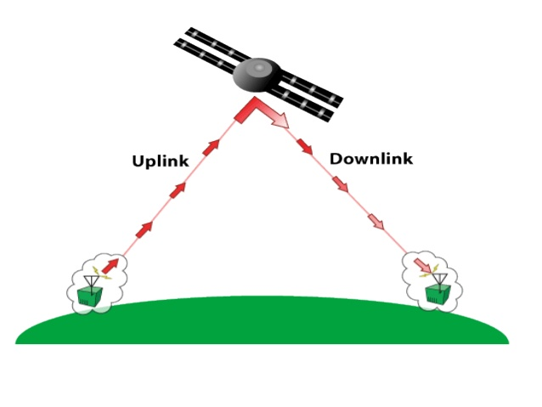
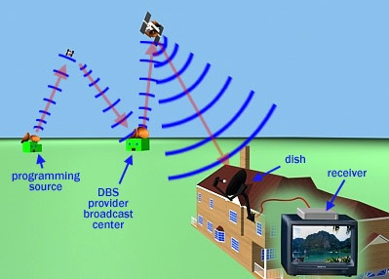
Working Principle

Slide 8
The two stations can use a satellite as a relay station for their communication
One Earth Station transmits the signals to the satellite.
Up link frequency is the frequency at which Ground Station is communicating with Satellite
The satellite Transponder converts the signal and sends it down to the second earth station. This frequency is called a Downlink frequency

Slide 9
Application
Weather Forecasting
Certain satellites are specifically designed to monitor the climatic conditions of earth. They continuously monitor the assigned areas of earth and predict the weather conditions of that region. This is done by taking images of earth from the satellite. These images are transferred using assigned radio frequency to the earth station.

Slide 10
Application
Radio and TV Broadcast
These dedicated satellites are responsible for making 100s of channels across the globe available for everyone. They are also responsible for broadcasting live matches, news, world-wide radio services. These satellites require a 30-40 cm sized dish to make these channels available globally.

Slide 11
Military Satellites
These satellites are often used for gathering intelligence, as a communications satellite used for military purposes, or as a military weapon. A satellite by itself is neither military nor civil. It is the kind of payload it carries that enables one to arrive at a decision regarding its military or civilian character.

Slide 12
Navigation Satellites
The system allows for precise localization world-wide, and with some additional techniques, the precision is in the range of some meters. Ships and aircraft rely on GPS as an addition to traditional navigation systems. Many vehicles come with installed GPS receivers. This system is also used, e.g., for fleet management of trucks or for vehicle localization in case of theft.

Slide 13
Global Mobile Communication
The basic purpose of satellites for mobile communication is to extend the area of coverage. Cellular phone systems, such as AMPS and GSM (and their successors) do not cover all parts of a country. With the integration of satellite communication, however, the mobile phone can switch to satellites offering world-wide connectivity to a customer. Satellites cover a certain area on the earth. This area is termed as a footprint of that satellite. Within the footprint, communication with that satellite is possible for mobile users.

Slide 14
Global Telephone
Imagine the link between Tanzania and a country like USA .Instead of using cables it was sometimes faster to launch a new satellite. But, fiber optic cables are still replacing satellite communication across long distance as in fiber optic cable, light is used instead of radio frequency, hence making the communication much faster (and of course, reducing the delay caused due to the amount of distance a signal needs to travel before reaching the destination.).

Slide 15
Using satellites, to typically reach a distance approximately 10,000 kms away, the signal needs to travel almost 72,000 kms, that is, sending data from ground to satellite and (mostly) from satellite to another location on earth. This cause‟s substantial amount of delay and this delay becomes
Connecting Remote Areas
World wide communication is possible due to satellite availability along with other technology

Slide 16
Advantages
Great coverage
Transmission cost of a satellite is independent of the distance from the center of the coverage
Very precise
Higher bandwidth

Slide 17
Disadvantages
Larger propagation delay in satellite communication than in terrestrial communication
Launching satellite into orbit is very costly, cost millions of dollar per launch
Bandwith is gradually becoming used
Gradual maintainace and monitor is needed

Slide 18
Kepler’s laws:
Satellites (spacecraft) orbiting the earth follow the same laws that govern the motion of the planets around the sun.
Kepler’s laws apply quite generally to any two bodies in space which interact through gravitation. The more massive of the two bodies is referred to as the primary, the other, the secondary or satellite.

Slide 19
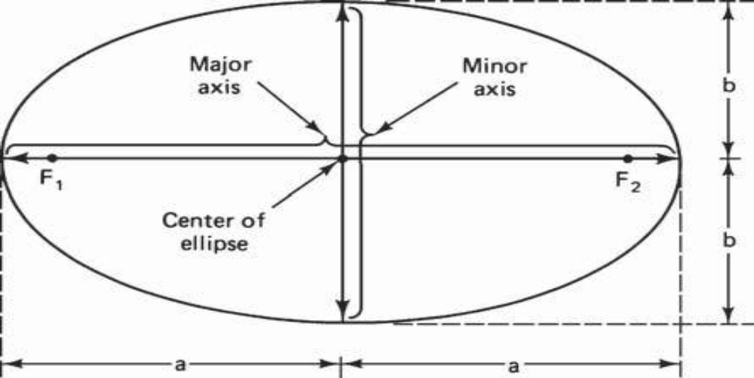
Kepler’s 1st law
Bodies move around the sun in elliptical orbits, with the sun at one focus. The other focus is empty.

Slide 20
An ellipse hast Two focal points shown as F1 and F2in above figure. The center of mass of the two-body system, termed the bary center, is always center of the foci.
Kepler's First Law is significant in that most ancient astronomers believed that the planets moved in circular orbits.

Slide 21
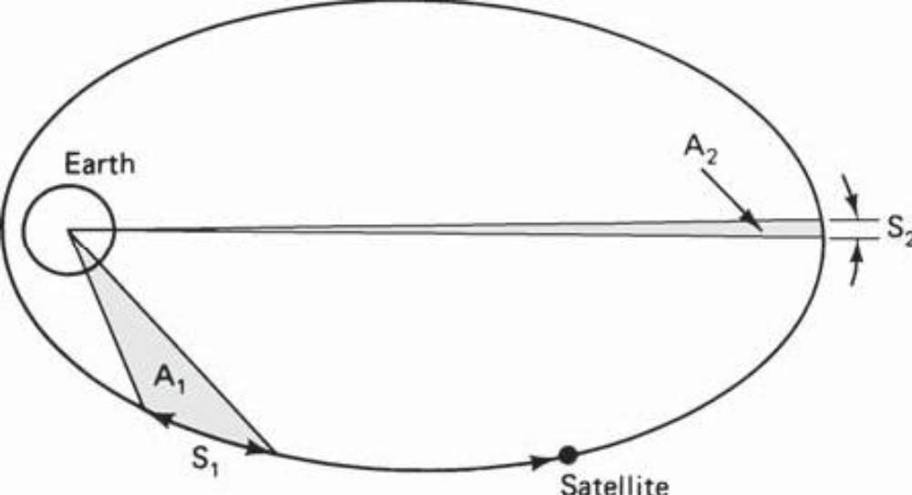
Kepler’s 2nd law
The radius vector sweeps out equal areas in equal times.

Slide 22
Kepler’s 3rd law
The square of the periodic time of orbit is proportional to the cube of the mean distance between the two bodies
T²∝ r³
T² = μ/r³
Where n is the mean motion of the satellite in radians per second and is the earth’s geocentric gravitational constant
μ=3.986005 X 1014m³/s²
^{i.e} Proof

Slide 23
Newton’s law:
Newton's 1st law:
An object at rest will remain at rest unless acted on by an unbalanced force. An object in motion continues in motion with the same speed and in the same direction unless acted upon by an unbalanced force. This law is often called "the law of inertia".

Slide 24
Newton's second law:
Acceleration is produced when a force acts on a mass. The greater the mass (of the object being accelerated) the greater the amount of force needed (to accelerate the object).
Newton's 3rd law:
For every action there is an equal and opposite re-action.

Slide 25
Classification/ Categories of Satellites
Satellites can be categorized in the following aspects
Depends on service:
Fixed service satellites(FSS): E.g. P2P communication
Broadcast service satellite(BSS): E.g. Satellite Tv/Radio
Mobile service satellite(MSS): E.g. Satellite phones
Depends on orbital position:
GEO, LEO and MEO

Slide 26
Introduction
Geostationary or geosynchronous earth orbit (GEO)
GEO satellites are synchronous with respect to earth. Looking from a fixed point from Earth, these satellites appear to be stationary. These satellites are placed in the space in such a way that only three satellites are sufficient to provide connection throughout the surface of the Earth (that is; their footprint is covering almost 1/3rd of the Earth). The orbit of these satellites is circular.

Slide 27
Conditions
1. The satellite should be placed 37,786 kms (approximated to 36,000 kms) above the surface of the earth.
2. Travel in the rotational speed of earth, and in the direction of motion of earth, that is eastward.
3. The inclination of satellite with respect to earth must be 0.

Slide 28
Lifetime is expectancy of these satellites is 15 years.
Geostationary satellite in practical is termed as geosynchronous .Factors which make these satellites shift from the ideal geostationary condition.
1. Gravitational pull of sun and moon makes these satellites deviate from their orbit. Over the period of time, they go through a drag. (Earth‟s gravitational force has no effect on these satellites due to their distance from the surface of the Earth.)

Slide 29
2. These satellites experience the centrifugal force due to the rotation of Earth, making them deviate from their orbit.
3. The non-circular shape of the earth leads to continuous adjustment of speed of satellite from the earth station.

Slide 30
Advantages
A GEO satellite’s distance from earth gives it a large coverage area, almost a fourth of the earth’s surface.
GEO satellites have a 24 hour view of a particular area.
Antennas need not be adjusted every now and then but can be fixed permanently.
The life-time of a GEO satellite is quite high usually around 15 years.

Slide 31
Disadvantages
A GEO satellite’s distance also cause it to have both a comparatively weak signal and a time delay in the signal, which is bad for point to point communication.
GEO satellites, centered above the equator, have difficulty broadcasting signals to near polar regions.
High transmission power is required.
Fixing a satellite at Geo stationary orbit is very expensive.

Slide 32
LOW EARTH ORBIT
LEO satellites are much closer to the earth than GEO satellites, ranging from 500 to 1,500 km above the surface.
• LEO satellites don’t stay in fixed position relative to the surface, and are only visible for 15 to 20 minutes each pass.
• A network of LEO satellites is necessary for LEO satellites to be useful

Slide 33
Using advanced compression schemes, transmission rates of about 2,400 bit/s can be enough for voice communication. LEOs even provide this bandwidth for mobile terminals with Omni-directional antennas using low transmit power in the range of 1W. The delay for packets delivered via a LEO is relatively low (approx 10 ms). The delay is comparable to long-distance wired connections (about 5–10 ms).

Slide 34
Smaller footprints of LEOs allow for better frequency reuse, similar to the concepts used for cellular networks. LEOs can provide a much higher elevation in Polar Regions and so better global coverage.

Slide 35
Advantages
A LEO satellite’s proximity to earth compared to a GEO satellite gives it a better signal strength and less of a time delay,
A LEO satellite’s smaller area of coverage is less of a waste of bandwidth.
Launching cost is cheap
Less transmission power

Slide 36
Disadvantages
A network of LEO satellites is needed, which can be costly
LEO satellites have to compensate for Doppler shifts cause by their relative movement.
Atmospheric drag effects LEO satellites, causing gradual orbital deterioration. Assuming 48 satellites and a lifetime of eight years, a new satellite would be needed every two months

Slide 37
Medium Earth Orbit (MEO) satellites:
MEOs can be positioned somewhere between LEOs and GEOs, both in terms of their orbit and due to their advantages and disadvantages.
Using orbits around 10,000 km, the system only requires a dozen satellites which is more than a GEO system, but much less than a LEO system. These satellites move more slowly relative to the earths rotation allowing a simpler system design.

Slide 38
Orbit somewere between 8,000Km and 18,000Km above the earth surface
Visible for much longer period of time,usually 2 to 8 hours
Larger coverage than LEO

Slide 39
Advantages
Longer duration of visibility and wider footprint.
Less satellites needed compared to that in LEO
Disadvantages
More delay than LEO but less than in GEO
The above three are the major three categories of satellites, apart from these, the satellites are also classified based on the following types of orbits:

Slide 40
Highly Elliptical Orbit (HEO) satellites
This orbit is made for satellites that do not revolve in circular orbits, only a very few satellite are operating in this orbit.

Slide 41
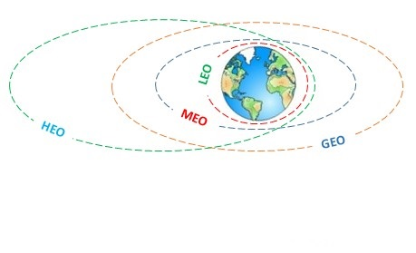

Slide 42
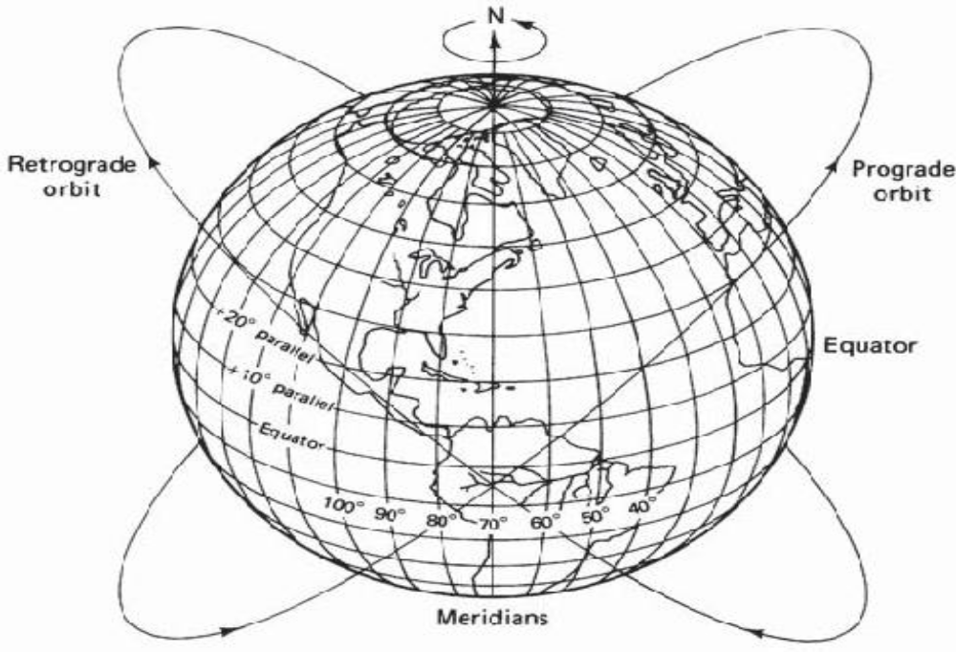
Orbital Paremeter

Slide 43
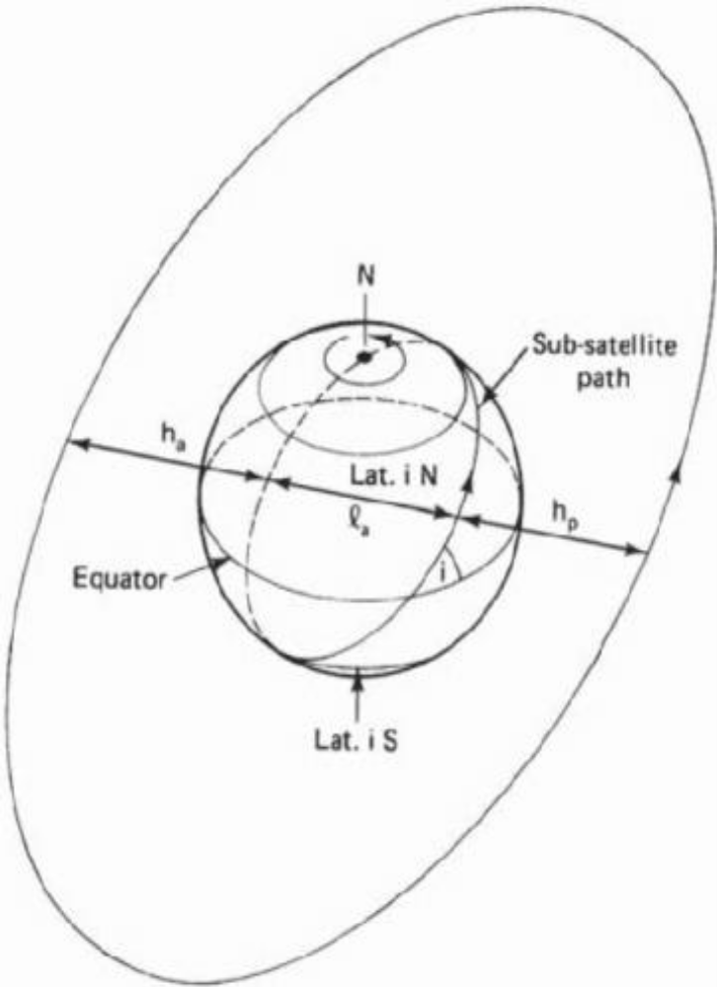
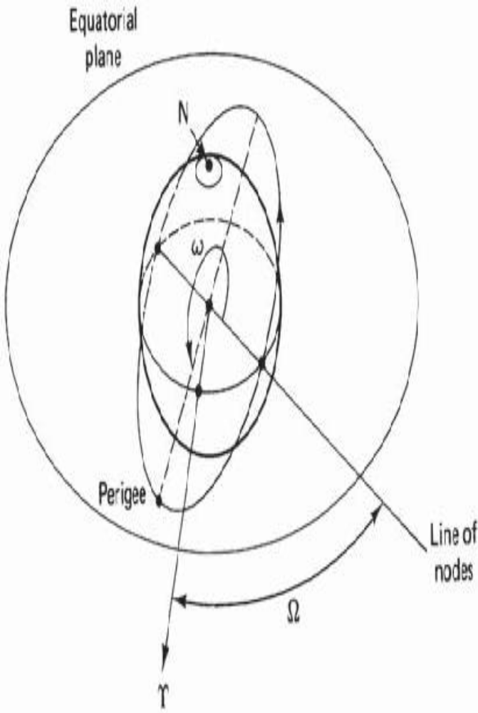

Slide 44
Apogee: A point for a satellite farthest from the Earth. It is denoted as ha.
Perigee: A point for a satellite closest from the Earth. It is denoted as hp.
Line of Apsides: Line joining perigee and apogee through centre of the Earth.It is the major axis of the orbit. One-half of this line‟s length is the semi-major axis equivalents to satellite‟s mean distance from the Earth.

Slide 45
Ascending Node: The point where the orbit crosses the equatorial plane going from north to south.
Descending Node: The point where the orbit crosses the equatorial plane going from south to north.
Inclination: the angle between the orbital plane and the Earth‟s equatorial plane. Its measured at the ascending node from the equator to the orbit, going from East to North. Also, this angle is commonly denoted as i.

Slide 46
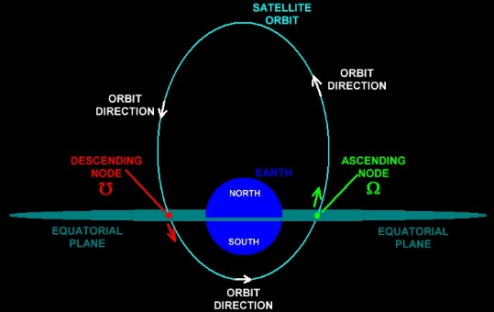

Slide 47
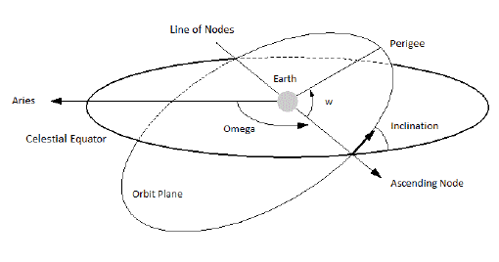

Slide 48
Line of Nodes: the line joining the ascending and descending nodes through the centre of Earth.
Prograde Orbit: an orbit in which satellite moves in the same direction as the Earth‟s rotation. Its inclination is always between 0 to 90. Many satellites follow this path as Earth‟s velocity makes it easier to lunch these satellites.
Retrograde Orbit: an orbit in which satellite moves in the same direction counter to the Earth‟s rotation.

Slide 49
Argument of Perigee: An angle from the point of perigee measure in the orbital plane at the Earth‟s centre, in the direction of the satellite motion.
Right ascension of ascending node: The definition of an orbit in space, the position of ascending node is specified. But as the Earth spins, the longitude of ascending node changes and cannot be used for reference. Thus for practical determination of an orbit, the longitude and time of crossing the ascending node

Slide 50
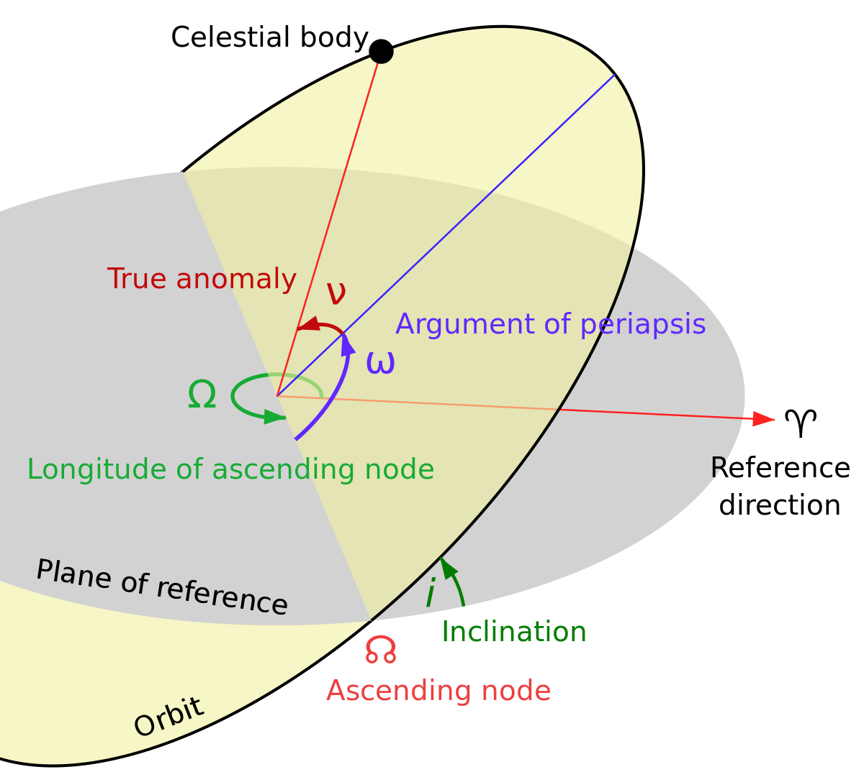

Slide 51
is used.For absolute measurement, a fixed reference point in space is required.It could also be defined as “right ascension of the ascending node; right ascension is the angular position measured eastward along the celestial equator from the vernal equinox vector to the hour circle of the object”.
Mean anamoly: It gives the average value to the angular position of the satellite with reference to the perigee.

Slide 52
True anamoly: It is the angle from point of perigee to the satellite‟s position, measure at the Earth‟s centre.

Slide 53
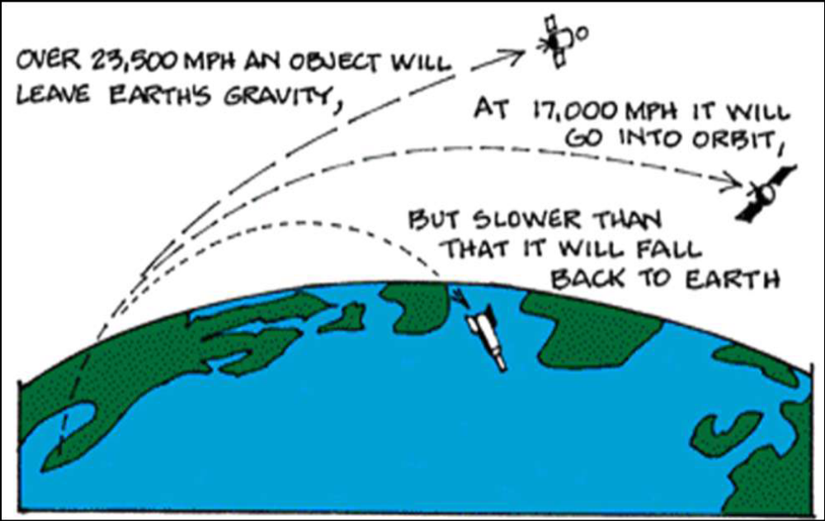
Launching Satellite

Slide 54
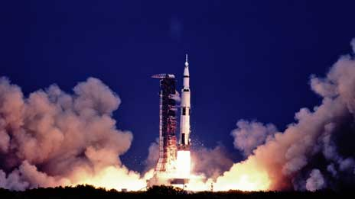
Launching Satellite

Slide 55
To keep the satellite in a stable circular orbit, the following equation must hold: Fg = Fc, i.e., both forces must be equal. Looking at this equation the first thing to notice is that the mass m of a satellite is irrelevant (it appears on both sides of the equation). Solving the equation for the distance r of the satellite to the centre of the earth results in the following equation:
r = (g·R²/(2·π·f)²)^{1/3}

Slide 56
m is the mass of the satellite;
R is the radius of earth with R = 6,370 km; R is the distance of the satellite to the centre of the earth;
g is the acceleration of gravity with g = 9.81 m/s2; ω is the angular velocity with
ω = 2·π·f,
f is the frequency of the rotation.

